Slide 1



Day 35
contact@anubhavtrainings.com
ABAP RESTFUL APPLICATION PROGRAMMING

Slide 2

Agenda – Day 35
What is ABAP Git
Why we use ABAP Git
ABAP Git Integration
Understand How to Use ABAP Git

Slide 3
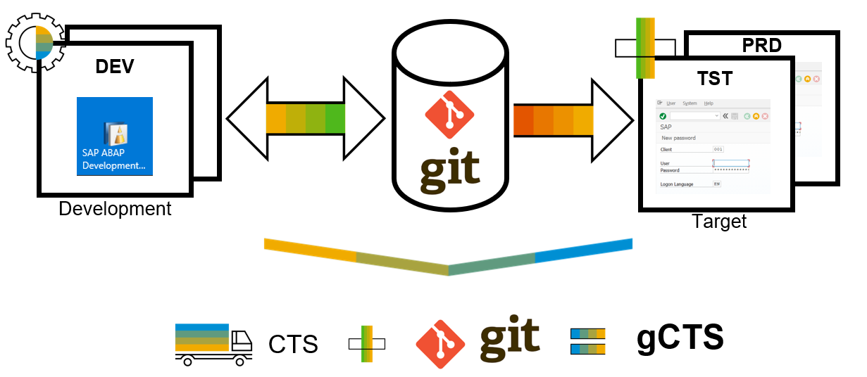
What is ABAP Git ?
abapGit is a tool to import and export code between ABAP systems. If a developer has a developer key to the system, the developer can perform these actions already. abapGit enables the developer to do mass export/changes/imports but not more than already possible to do manually.
Running automated security checks on the abapGit code will by design give a lot of errors, as abapGit will import, overwrite and change ABAP artifacts in the system in ways that might not be intended. Always review all code in remote repositories before importing to the target system, this is possible because abapGit is plain text unlike traditional transport files.
That being said, abapGit is used by mutiple organizations, all abapGit changes are reviewed via pull requests. And all 100+ repository watchers are automatically notified for every change to the code base, so potentially all changes are looked at by more people than tradtional enterprise products.

Slide 4
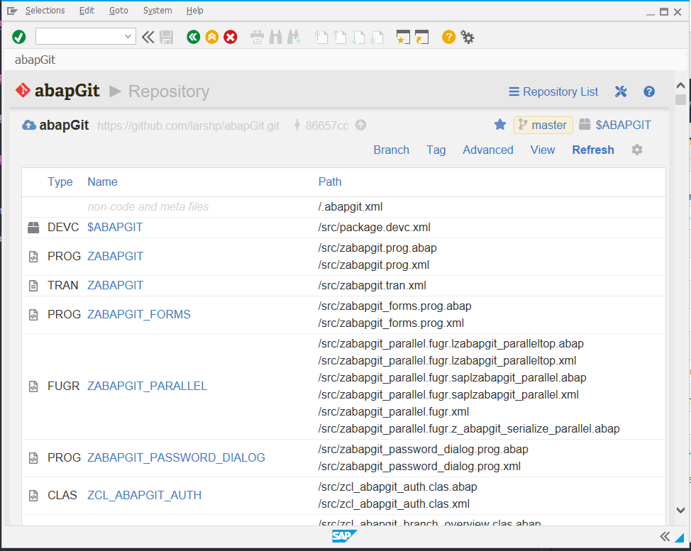
ABAP Git
It is a community effort to support the project, recommend watching the project to get a feeling about issue resolution. Everyone can suggest changes to abapGit via pull requests.

Slide 5
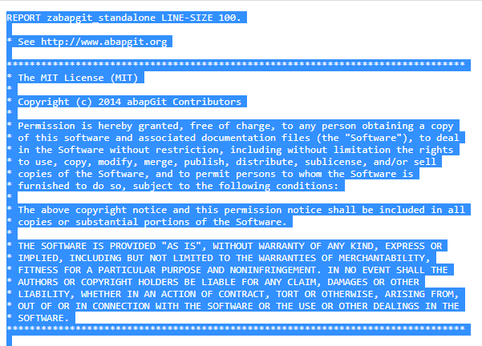
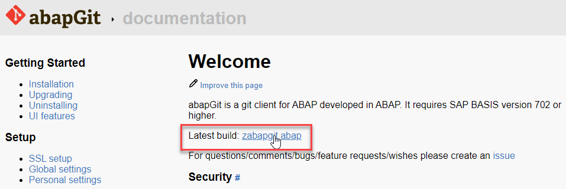
ABAP Git Integration
Step 1. Go to https://docs.abapgit.org/ in browser and click on Latest Build.
Step 2. Copy this Code.

Slide 6
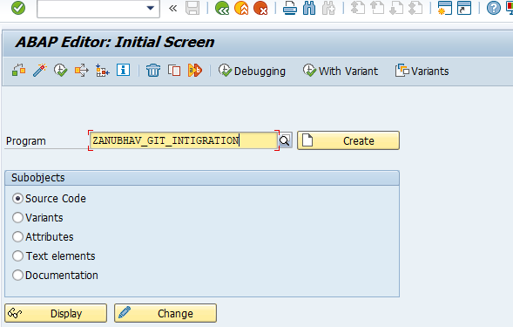
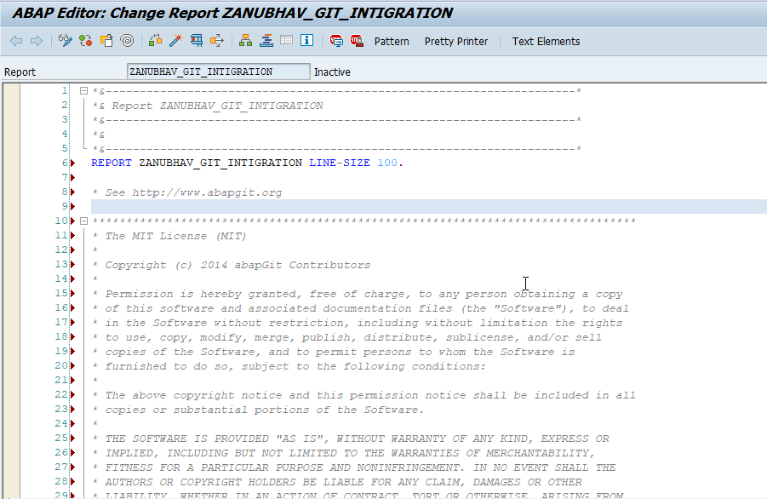
ABAP Git Integration
Step 3. Open SAP Gui Go to T-Code SE38 for Building Report, give any name to report and click on create.
Step 4. Paste the Copied Copy in this report.

Slide 7
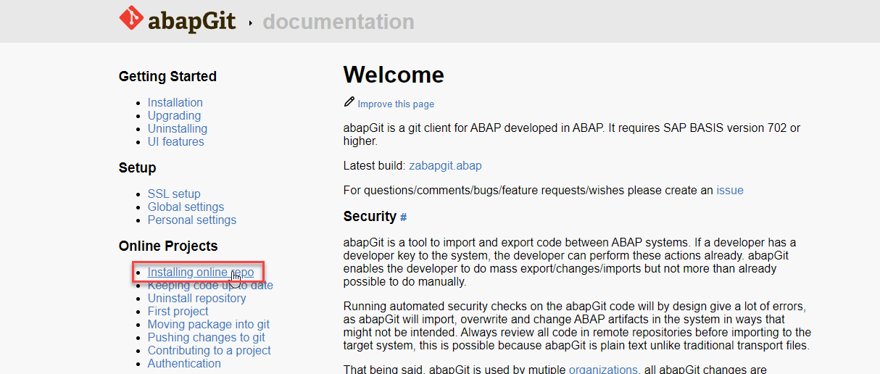
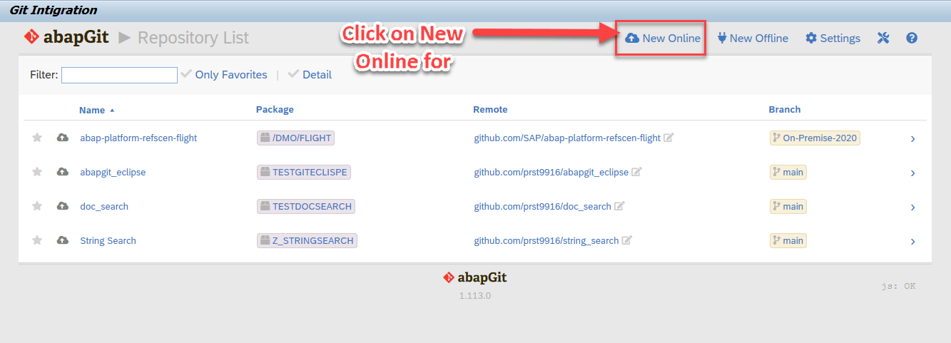
ABAP Git Integration
Step 5. After the Execution, abapGit Screen
Step 6. Go back to Bowser side and click on Installing Online Repo

Slide 8
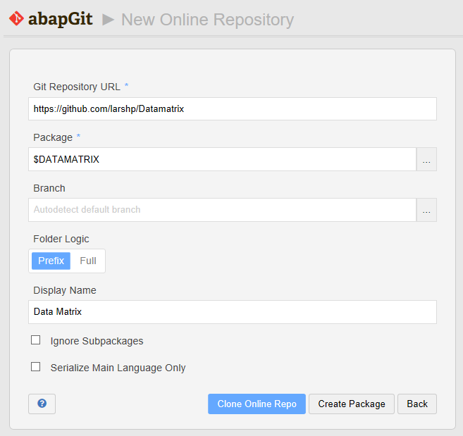
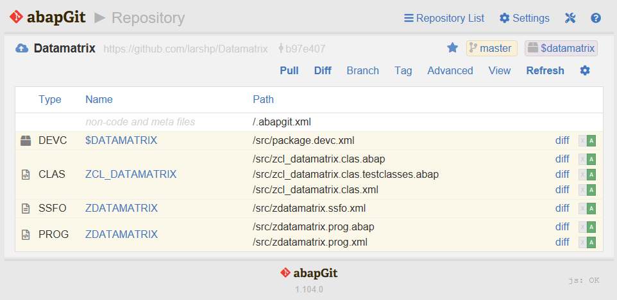
ABAP Git Integration
Step 7. Enter the url for the Github project, eg https://github.com/larshp/Datamatrix along with a package name, eg. $DATAMATRIX. If the package does not exist yet, it will be created automatically when pulling. Alternatively, you can select “Create Package” to create the package manually with your own settings.
Step 8.Select “Clone Online Repo”
Select “Pull” to copy all objects from the Git repository into the SAP system

Slide 9

End of Day 35
www.Anubhavtrainings.com

Slide 10

www.Anubhavtrainings.com

Slide 11
THANK YOU
If you cannot do
great things, do small things in a great way.
Anubhav Oberoy
https://www.anubhavtrainings.com

Slide 12


We’re committed to empower you to be
Most Desirable Resource
through powerful training solutions.
We build the workforce of the future.
250+
Corporate Clients
30,000+
Learners Trained
25000+
Learners Placed
FREE WEBINARS
Sign up for free webinars with industry experts every fortnight!
Enroll Now!
Contact us today!
https://anubhavtrainings.com/

Slide 13




More from AnubhavTrainings.com

